Slide 1
Introduction to Mobile Application Development
Instructor: NGUYEN ANH MINH (M. Sc.)
Intelligence Business Solutions VietNam Ltd
Email: nguyen.anh.minh@inte.co.jp

Slide 2
Agenda
Why do we learn this course ?
What is course talking about ?
How do we learn this course more effectively ?

Slide 3
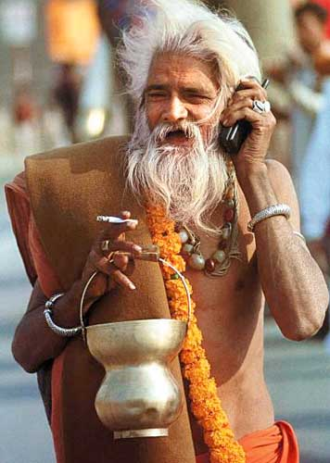
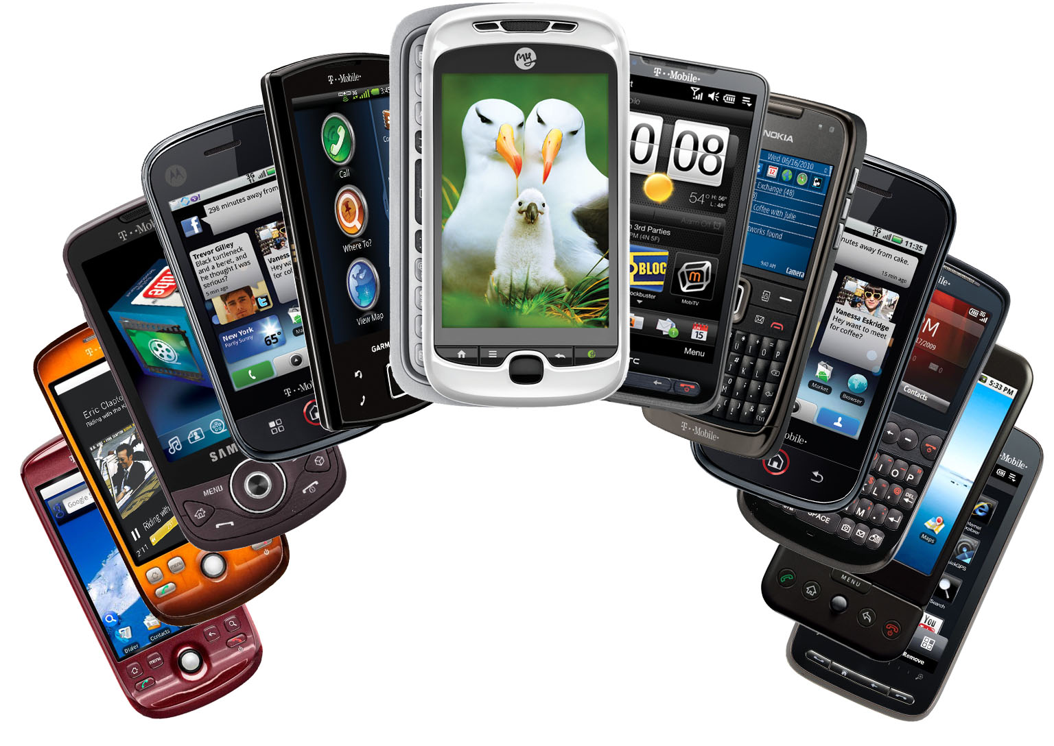


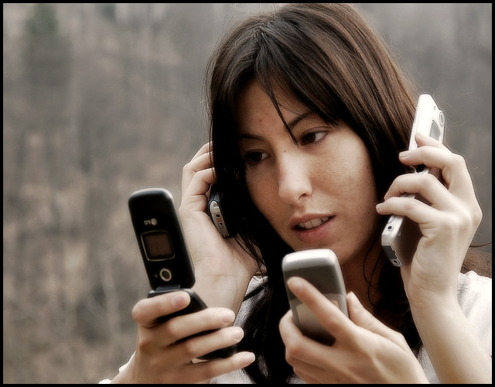
Why do we learn this course ?
1.
Mobile phones
are everywhere
2. An important part of our life
3. The world is not a desktop
Notes:
Mobile phones are everywhere
The world is not a desktop
Asdf

Slide 4
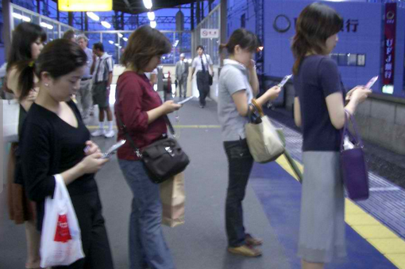
Mobile phones are everywhere

Slide 5


@ Airport

Slide 6
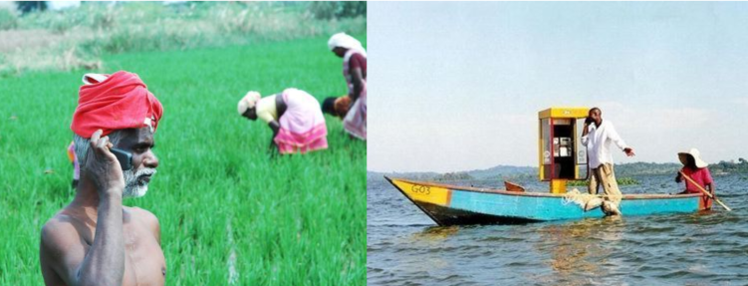
Rural area

Slide 7
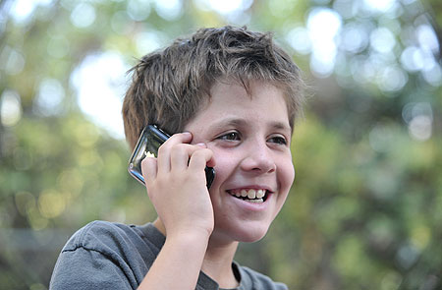
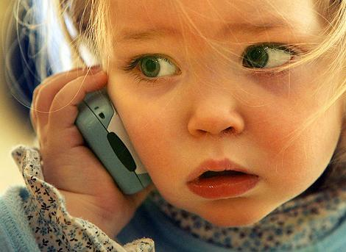



Slide 8






3. The world is not a desktop
2011, World populations 7 billion people, 5.6 billion mobile phones
2011, USA, 327.5/310, 103.9%
2009, GER, 107/82, 130%
2008, UK, 75.7/61.6, 123%
2010, VIETNAM, 72/90, 79%
Source: http://en.wikipedia.org/wiki/List_of_countries_by_number_of_mobile_phones_in_use

Slide 9
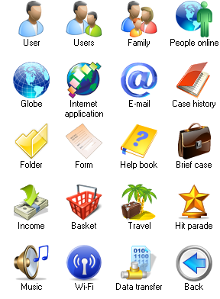
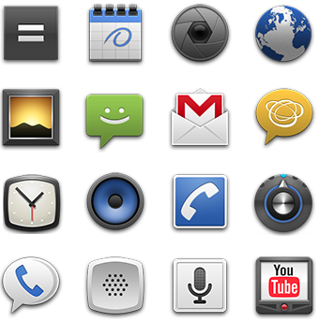
Are there enough software for eveyone ?
Notes:
In desktop we have plenty
In phone: more interesting, many to come !

Slide 10
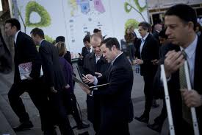
That’s why we learn this course !
The world is going mobile
Many challenges
You can find more reasons

Slide 11
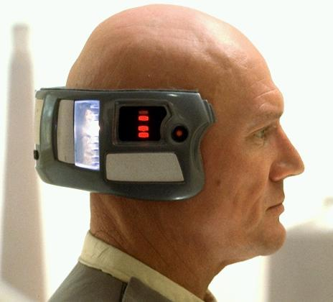
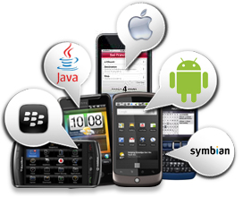



What is course talking about ?
Introduce the mobile phone for 21st century
How to develop an innovative program on Mobile phone
What area can we apply this skill for
Notes:
1) In the next few slides, I will detail about mobile phone in 21st century.
It is fantastic !
2) Focus on J2ME, Android. Not everything.
There are Symbian, Windows, Blacberry, iOS (to expensive)
I do support iOS, but anyone like it can ask after the class.
3) What can we do with this !

Slide 12
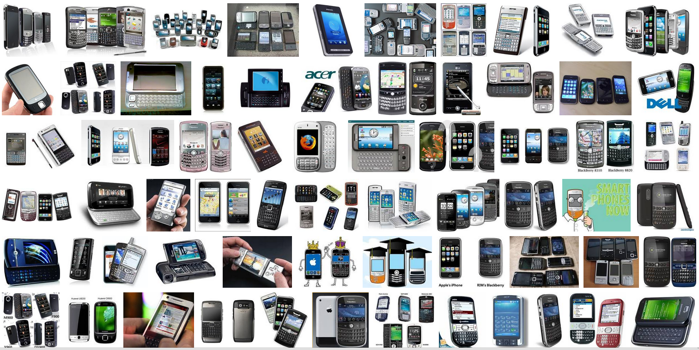
The mobile phone of the 21 century
Notes:
First of all, we need to understand our subject of study
What are they ?
Why they are interesting ?

Slide 13
The mobile phone of the 21 century
It has Operating
System
Smart
Mobile
It has Sensors
It is powerful
Network connections
It is an entertainment device
Notes:
Thông minh – “smart”
Mạnh mẽ: Ex: dual-core
Nhiều tính năng
Mp3, video, chat, web, games
Kết nối mạng
Mobile office, social network
Cameras
Sensors

Slide 14


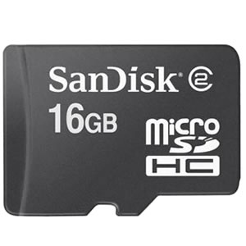
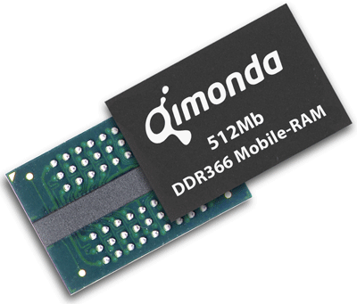
The phone is powerful
Multi-core CPU
Plenty of RAM
Heaps of external storage
Notes:
H

Slide 15
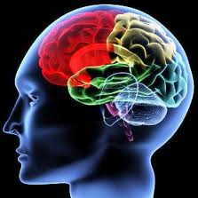

CPU Core
CPU: Central Processing Unit
Notes:
Why I am concern ?
Because of :
1)
2)
3)

Slide 16
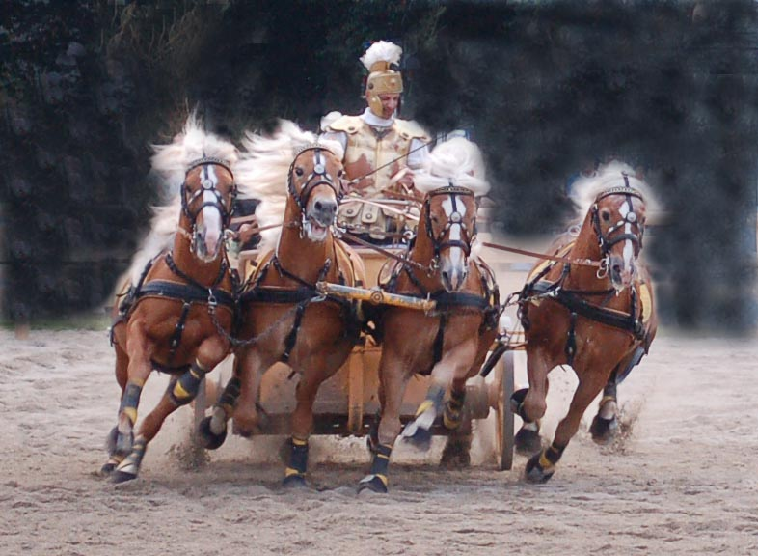
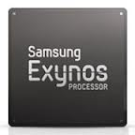
Quad-core
Quad cores = 4 cores
Means:
4 “CPU” in a box
More powerful, stronger
More engergy consumption
More difficult to manage

Slide 17
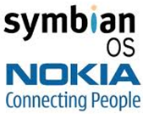



It has operating system

Slide 18


Connectivities – Wide range
3G

Slide 19




Connectivities – Short range

Slide 20
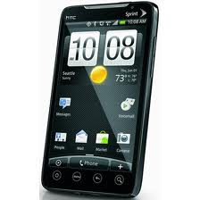
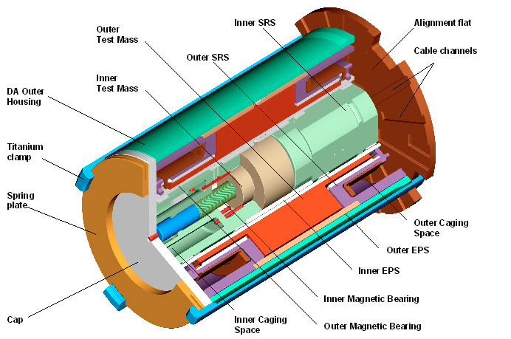
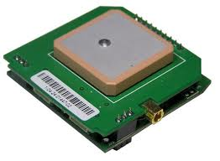
It has sensors
Touch Screen
Accelerometer
GPS receiver
Notes:
Capacitor Sensor: http://www.youtube.com/watch?v=JVRuDY4X88M
Accelerometer: http://www.youtube.com/watch?v=KZVgKu6v808
GPS : http://www.youtube.com/watch?v=EOwMkFsJXRI
http://www.skytel.com/products/Assisted_GPS.pdf

Slide 21
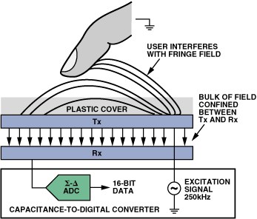
Capacitor Sensor
Human body is a capacitor
Notes:
Capacitor Sensor: http://www.youtube.com/watch?v=JVRuDY4X88M

Slide 22
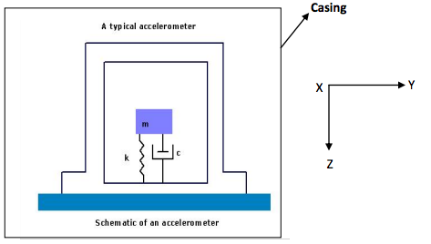
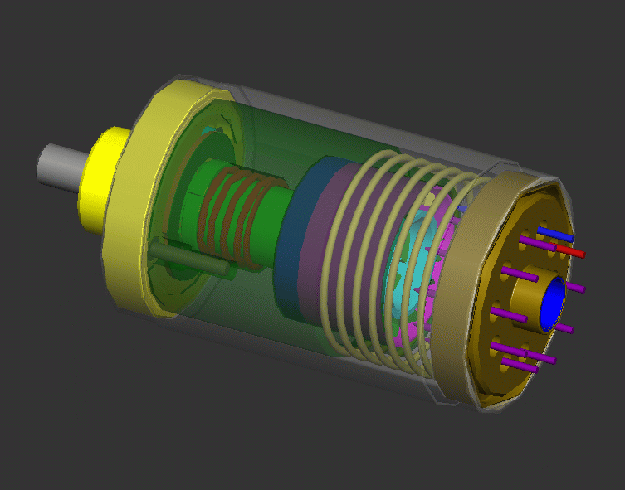
Accelerometer
http://www.youtube.com/watch?v=KZVgKu6v808
Notes:
Accelerometer: http://www.youtube.com/watch?v=KZVgKu6v808

Slide 23
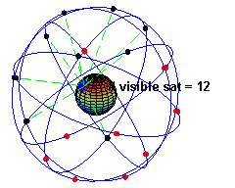
GPS – Global Positioning System
It first used in US Army for navigation
Now it is free for civiliants
Triangulation algorithm
Visible satelite (at least 3)
It is pervasive / outdoor
Notes:
GPS : http://www.youtube.com/watch?v=EOwMkFsJXRI
http://www.skytel.com/products/Assisted_GPS.pdf
tail -f /dev/cu.BTGPS74R-SPP

Slide 24
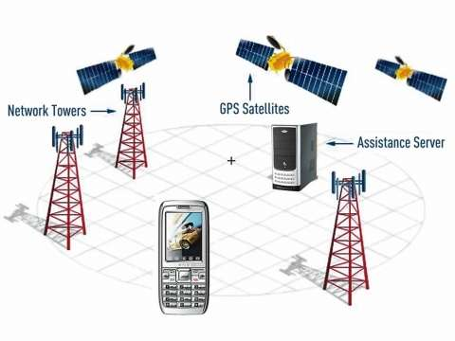
Assisted GPS (A-GPS) (on smartphones)

Slide 25
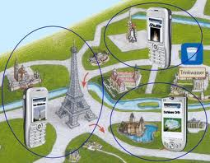
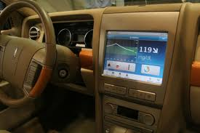
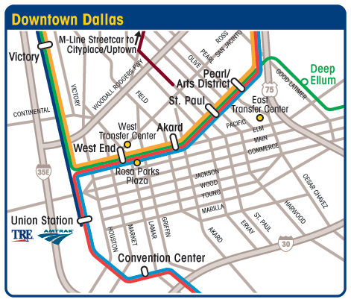
Map related applications
Location based Services
Navigation Based Services
Routing Services

Slide 26
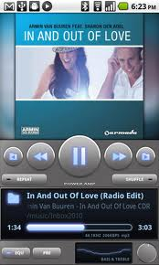
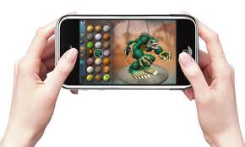
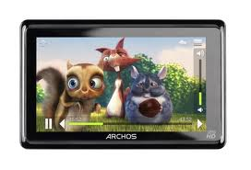
It is an Entertainment Device

Slide 27
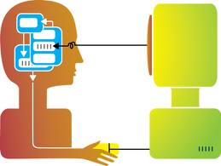
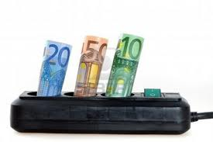
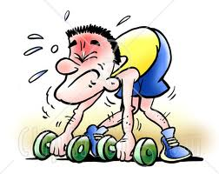
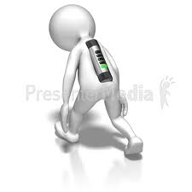


The smartphones problems
Difficult to interact
Expensive
Battery life
Social issues
Distraction

Slide 28
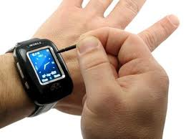
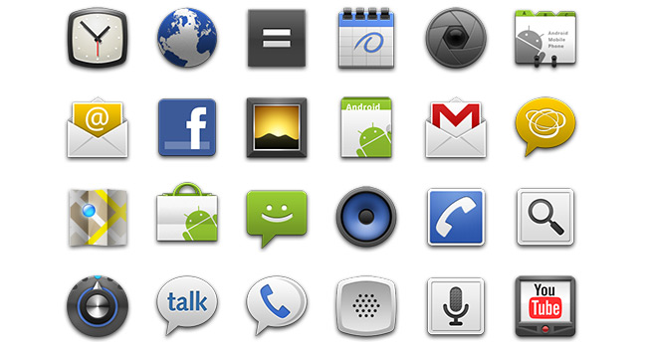
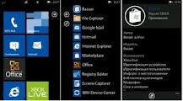
Difficult Interaction
Small Screen
Icon based ?
Menu based ?
Too complicated

Slide 29


Short battery life
Battery Awareness
How much energy that your app uses ?

Slide 30
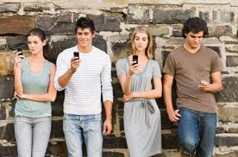
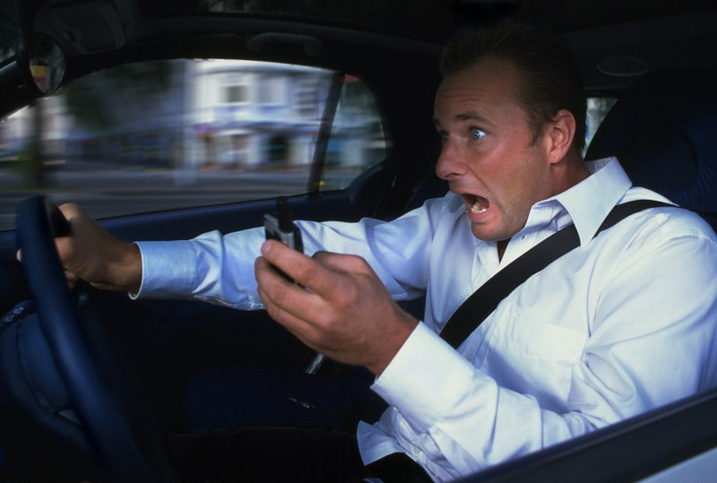

Social issues
Mobile phones have changed our way of communication
Isolationism
Distractions

Slide 31
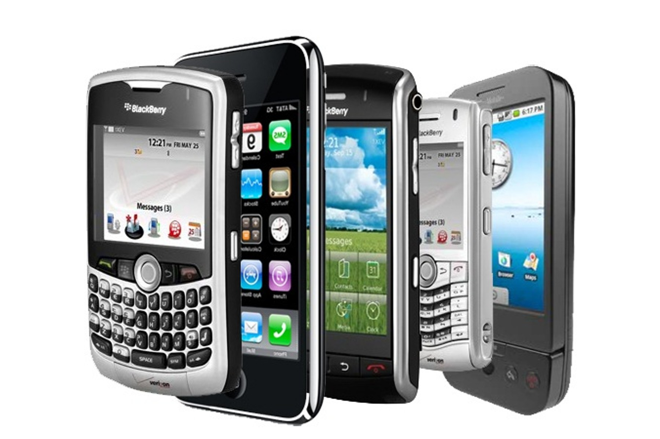
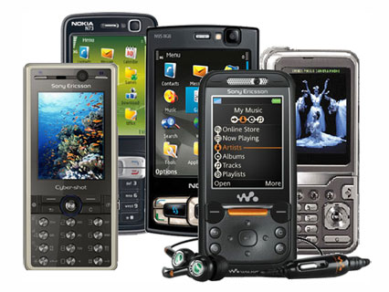
Though, there are many difficulties: We still love them !
Everything goto Mobile

Slide 32
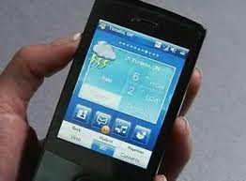
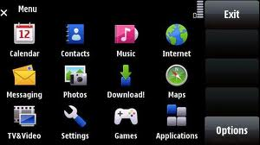
User experience
GUI
Menu & Navigation
Intuitive

Slide 33
Lab exercises
Android (Android Studio, Android SDK, Simulators)
iOS (Xcode, Cocoa Touch SDK, Other SDK)
Hybrid (Ionic, cordova, others,)

Slide 34
Work description:
Name: Your name
Exercises
Contact by Email address
Individual student:
Work individually
Communication via Email
Positively

Slide 35
Projects
Projects will be given after some materials
Individual students will choose the project or propose their own project.
Working during & after course.
Supervision over email and Github.

Slide 36
Conclusion
The world is going mobile !
The goals of this course:
How to write a program on Android, IOS, Hybrid,
Ideas on Mobile Application Development
Provides learning skills
Notes:
1) Therefore we need to do something on it
2)

